Slide 1
Introduction To Q-learning
Scott O’Hara
Metrowest Developers Machine Learning Group
5/13/2020

Slide 2
References
CS188 - Introduction to Artificial Intelligence course at University of California, Berkeley:
http://ai.berkeley.edu/home.html
http://gamescrafters.berkeley.edu/~cs188/sp20/
CS181 - Machine Learning course at Harvard University:
Lectures and notes from multiple offerings of CS181: Spring 2009, 2011, 2014 and 2017.
“Demystifying Deep Reinforcement Learning,” 2015, Tambet Matiisen
https://www.intel.ai/demystifying-deep-reinforcement-learning/
Reinforcement learning: an introduction R. S. Sutton and A. G. Barto, Second edition. Cambridge, Massachusetts: The MIT Press, 2018.

Slide 3
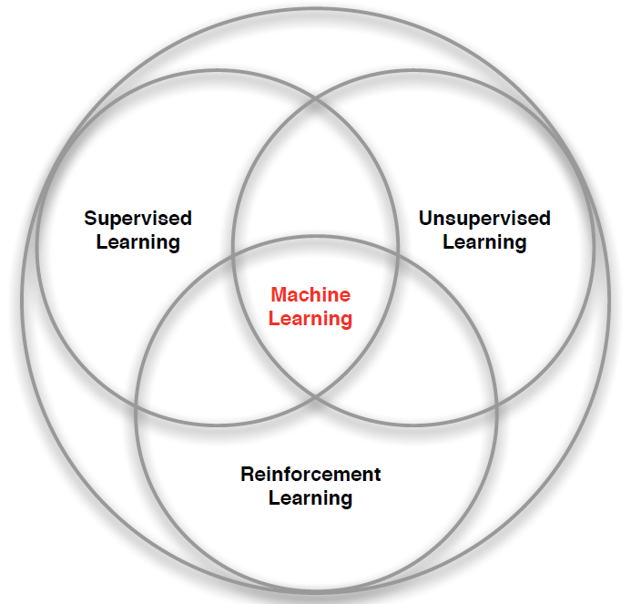
3 Types of Machine Learning
Supervised Learning – Learn a function from labeled data that maps input attributes to an output label e.g., linear regression, decision trees, SVMs.
Unsupervised Learning – Learn patterns in unlabeled data e.g., principle component analysis or clustering algorithms such as K-means, HAC, or Gaussian mixture models.
Reinforcement Learning – An agent learns to maximize rewards while acting in an uncertain environment.
Credit: image borrowed from lecture slides David Silver, DeepMind, “Introduction to Reinforcement Learning

Slide 4
The Markov Decision Process
The Markov Decision Process (MDP) provides a mathematical framework for reinforcement learning.
Markov decision processes use probability to model uncertainty about the domain.
Markov decision use utility to model an agent’s objectives. The higher the utility, the “happier” your agent is.
MDP algorithms discover an optimal decision policy (π) specifying how the agent should act in all possible states in order to maximize its expected utility.

Slide 5
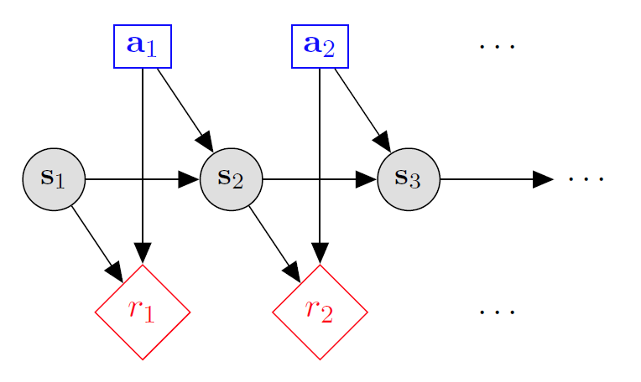

Markov decision processes
States: $s_{1},…,s_{n}$
Actions: $a_{1},…,a_{m}$
Reward model:
$R\left(s,a,s′\right)∈R$
Transition model:
$T\left(s,a,s′\right)=$ $P\left(s′ | s, a\right)$
Discount factor: $γ∈\left[0,1\right]$
<https://en.wikipedia.org/w/index.php?title=Markov_decision_process&oldid=855934986> [accessed 11 September 2018]

Slide 6
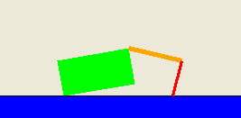
Application: Crawler robot
Arm
Location
Hand
States: <Location, Arm angle, Hand angle>
Actions: increase Arm angle, decrease Arm angle,
increase Hand angle, decrease Hand angle.
Reward model: +1 if robot moves right, -1 if robot moves left.
Transition model: model of box movement caused by arm movements.

Slide 7

The Reinforcement Learning Problem
Agent
State: s’
Reward: r
Actions: a
Environment
Agent must learn to act to maximize expected rewards.
Agent knows the current state s, takes an action a, receives a reward r and observes the next state s’.
$S_{0}, A_{0}, R_{0},S_{1}, A_{1}, R_{2},S_{2}, A_{2}, R_{2},…,S_{n}, A_{n}, R_{n},S_{T}$
Agent has no access to the reward model r(s,a,s’) or the transition model T(s,a,s’).

Slide 8
Reinforcement Learning Algorithms Based on the Markov Decision Process
With MDPs, the reward and transition models together are simply called the model.
Reinforcement learning algorithms can be classified by whether the agent has a model the environment.
Algorithms with Distribution Models
Model-free Algorithms
Algorithms with Sample-based Models

Slide 9
Algorithms with Distribution Models
Probability distributions are known for both the reward and transition models.
Value iteration algorithms build a value function using dynamic programming.
Policy iteration algorithms: build a policy directly by using dynamic programming.
See my presentation slides from 2/26/2020 entitled “Model-based Reinforcement Learning” at:
https://github.com/MetrowestBostonDevelopersMLGroup/MeetingPresentations/tree/master/2020

Slide 10
Model-Free RL Algorithms
Model-free RL algorithms have knowledge of the states and actions but …
have no knowledge of the reward and transition models of the problem space and…
make no attempt to learn to learn these models.
Instead, attempts to learn the Q-Values of every state-action pairs i.e., the expected payoff of a particular action taken in a given state.
Examples of model-free RL algorithms include: Q-Learning, Monte-Carlo, SARSA, Expected SARSA, Deep Q-learning, etc.

Slide 11
Algorithms with Sample-Based Models
Between full-knowledge RL algorithms with a distribution model and model-free RL algorithms there are RL algorithms with sample-based models.
Sample-based RL algorithms construct approximate transition and reward models by collecting statistics about transitions and rewards from the environment.
These algorithms exploit their approximate models by using them to periodically improve their value functions or policies off-line.
Examples of RL algorithms with sample-based models include: Dyna-Q, real-time dynamic programming (RTDP), Prioritized Sweeping, Expectimax, etc.

Slide 12
Model-Based RL pros and Cons
Pros:
Makes greater use of experience.
Solves the model optimally given enough experience.
Cons:
Requires a computationally more expensive solution procedure.
Requires the model to be small enough to solve due to combinatorial issues.

Slide 13
Model-Free RL pros and Cons
Pros:
The solution procedure is much more efficient.
Can handle much larger MDPs.
Cons:
Learns more slowly.
Does not learn as much as a model-based RL in a single training episode since it doesn’t learn the transition and reward models.

Slide 14
Model-Free → Sample-Based Models→ Distribution models
Generally, these algorithms lie along a continuum from model-free algorithms to model-based.
Different algorithms represent different trade-offs with respect to:
computational complexity
model accuracy
execution speed
memory usage
etc.

Slide 15
Q-Learning

Slide 16
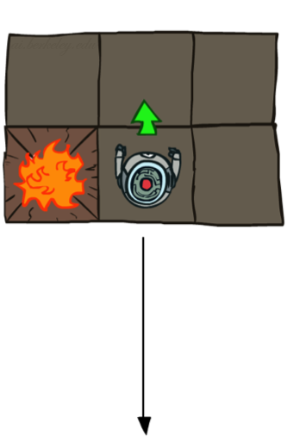
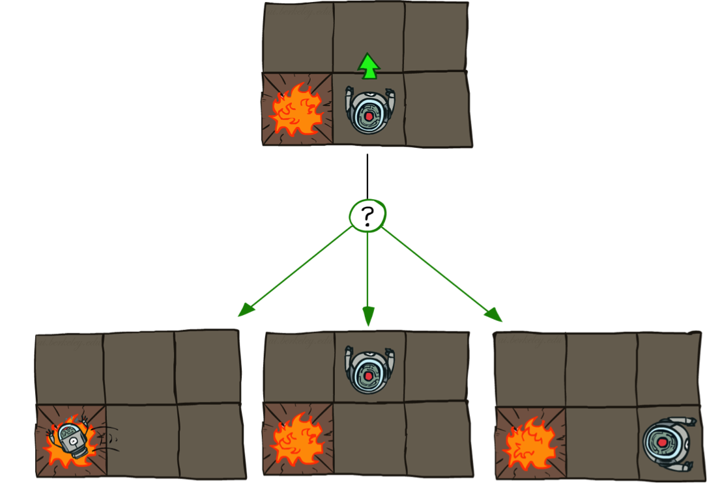
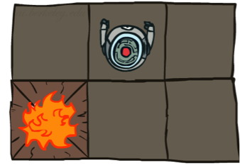
Example: GRID World
Deterministic Grid World
Stochastic Grid World

Slide 17
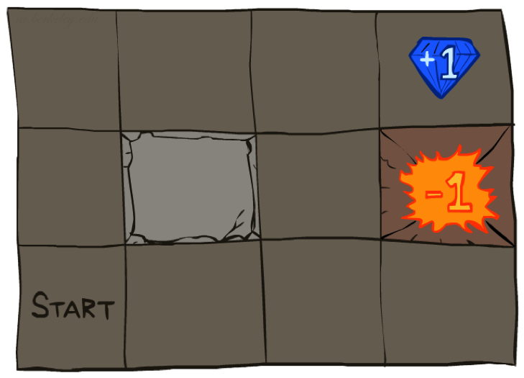




Example: Grid World
A maze-like problem
The agent lives in a grid
Walls block the agent’s path
Noisy movement: actions do not always go as planned
80% of the time, the action North takes the agent North (if there is no wall there)
10% of the time, North takes the agent West; 10% East
If there is a wall in the direction the agent would have been taken, the agent stays put
The agent receives rewards each time step
Small “living” reward each step (can be negative)
Big rewards come at the end (good or bad)
Goal: maximize sum of rewards
Notes:
[cut demo of moving around in grid world program]

Slide 18
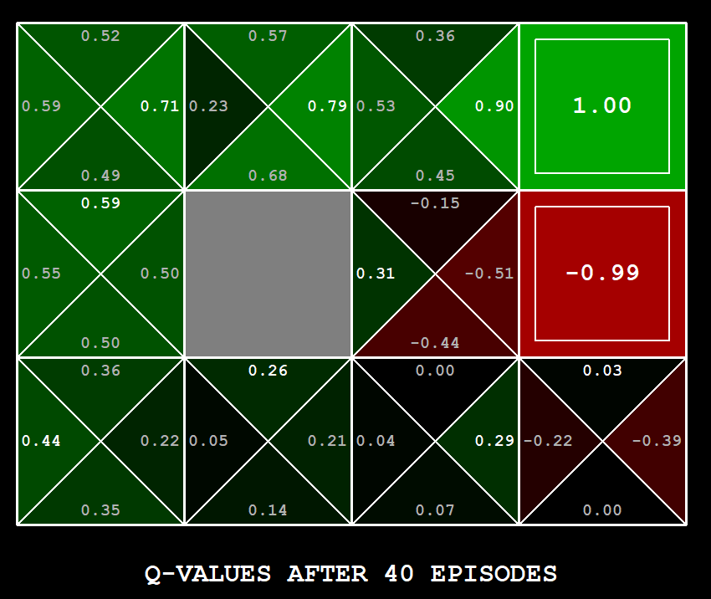
Q-Learning Example: gridworld
States: <x, y> locations
Actions: move north, south, east or west.
Reward model:
+1 if robot moves to <3, 2>
-1 if robot moves <3, 1>
otherwise, get “living reward”.
Transition model:
n – probability of unintended (noisy) action.
1-n probability of intended action.
stay put if you move into a wall.
DEMO:
# run manually using arrows keys (-m)
python gridworld.py -w 200 -k 40 -s 0.2 -a q -d 1.0 -m
Notes:
python gridworld.py -k 40 -w 200 -s 2.0 -a q –v [-p]

Slide 19
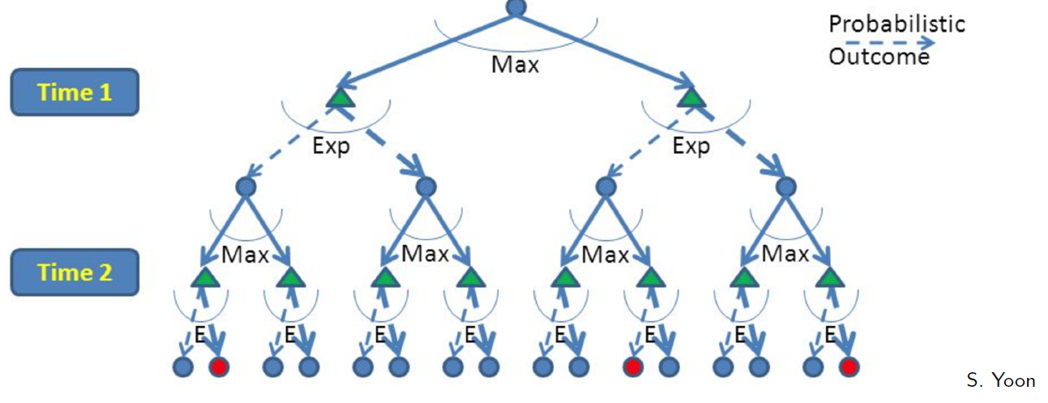
RL is like A game against Nature
Reinforcement learning is like a game-playing algorithm.
Nodes where you move are called states: S ( )
Nodes where nature “moves” are called Q-states: <S,A> ( )
Credit: CS188 – Intro to AI, UC Berkeley, ai.berkely.edu

Slide 20
Quantities to optimize
The value (utility) of a state s:
V(s) = expected utility starting in s and acting optimally thereafter.
The value (utility) of a q-state (s,a):
Q(s,a) = expected utility when taking action a from state s and acting optimally thereafter.
The policy π:
π(a|s) = probability of action a from state s
s
s is a state
a
(s, a) is a q-state
s, a
s,a,s’
(s,a,s’) is a transition
s’
Credit: CS188 – Intro to AI, UC Berkeley, ai.berkely.edu
Notes:
Demo just shows V and Q values, snapshots on next slides.

Slide 21

The Bellman Equations
The Bellman Value Equations define a relationship, which when satisfied gives the expected value for $V(s)$ and $Q\left(s,a\right)$for a given policy π.
The Bellman Optimality Equations define a relationship, which when satisfied guarantees that $V(s)$ and $Q\left(s,a\right)$ are optimal for each state and action.
This in turn guarantees that the policy $π^{∗}$is optimal.
There is one equation $V^{∗}(s)$ for each state s.
There is one equation $Q^{∗}\left(s,a\right)$ for each state s and action a.
s
a
s, a
s,a,s’
s’
Credit: CS188 – Intro to AI, UC Berkeley, ai.berkely.edu
Credit: CS181 – Machine Learning, D. Parkes, Harvard Univ, Spring 2017
Notes:
Let’s start by equations that characterize these quantities through mutual recursions. [step through this by writing on slide, one step at a time]
Recursive characterization of V* in terms of V*; not necessarily helpful; but it is a characterization.
Note: this is a set of equations that needs to be satisfied; but it could have multiple solutions (it does not, but at this stage of our knowledge it could).

Slide 22
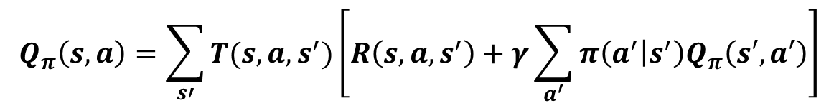
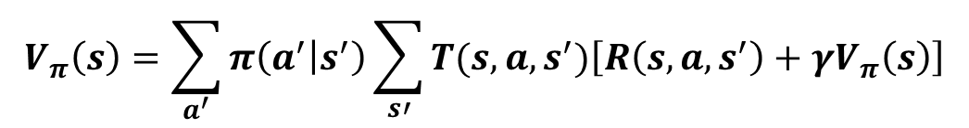
The Bellman VALUE Equations
State Value Equation:
s
$$V_{π}\left(s\right)=\sum_{a^{′}}{π\left(a^{′} | s^{′}\right)}\sum_{s′}{T(s,a,s^{′})\left[R\left(s,a,s^{′}\right)+γV_{π}\left(s\right)\right]}$$
a
s, a
Action Value Equation:
s,a,s’
s’
$$Q_{π}\left(s,a\right)=\sum_{s′}{T(s,a,s^{′})\left[R\left(s,a,s^{′}\right)+γ\sum_{a^{′}}{{π\left(a^{′} | s^{′}\right)Q}_{π}\left(s′,a′\right)}\right]}$$
Simplifying Assumption: rewards are fixed for (s, a, s’)
Credit: CS188 – Intro to AI, UC Berkeley, ai.berkely.edu
Credit: CS181 – Machine Learning, D. Parkes, Harvard Univ, Spring 2017
Notes:
Let’s start by equations that characterize these quantities through mutual recursions. [step through this by writing on slide, one step at a time]
Recursive characterization of V* in terms of V*; not necessarily helpful; but it is a characterization.
Note: this is a set of equations that needs to be satisfied; but it could have multiple solutions (it does not, but at this stage of our knowledge it could).

Slide 23


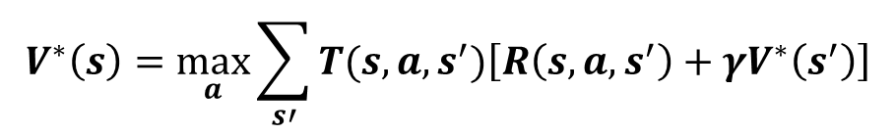
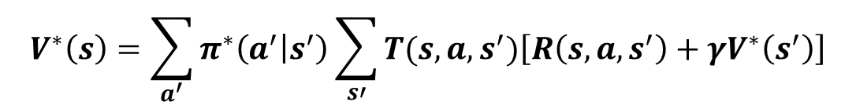
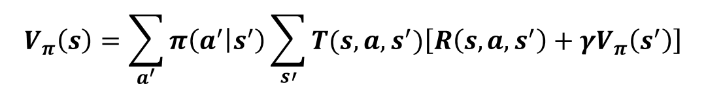
Bellman Optimality Equation for $V^{∗}$
State value equation:
$$V_{π}\left(s\right)=\sum_{a^{′}}{π\left(a^{′} | s^{′}\right)}\sum_{s′}{T(s,a,s^{′})\left[R\left(s,a,s^{′}\right)+γV_{π}\left(s^{′}\right)\right]}$$
s
a
Substitute optimal policy:
s, a
$$V^{∗}\left(s\right)=\sum_{a^{′}}{π^{∗}\left(a^{′} | s^{′}\right)}\sum_{s′}{T(s,a,s^{′})\left[R\left(s,a,s^{′}\right)+γV^{∗}\left(s^{′}\right)\right]}$$
s,a,s’
s’
Optimality equation for $V^{∗}$:
$$V^{∗}\left(s\right)=\max_{a}{\sum_{s′}{T(s,a,s^{′})\left[R\left(s,a,s^{′}\right)+γV^{∗}\left(s^{′}\right)\right]}}$$
Simplifying Assumption: rewards are fixed for (s, a, s’)
Credit: CS188 – Intro to AI, UC Berkeley, ai.berkely.edu
Credit: CS181 – Machine Learning, D. Parkes, Harvard Univ, Spring 2017
Notes:
Let’s start by equations that characterize these quantities through mutual recursions. [step through this by writing on slide, one step at a time]
Recursive characterization of V* in terms of V*; not necessarily helpful; but it is a characterization.
Note: this is a set of equations that needs to be satisfied; but it could have multiple solutions (it does not, but at this stage of our knowledge it could).

Slide 24

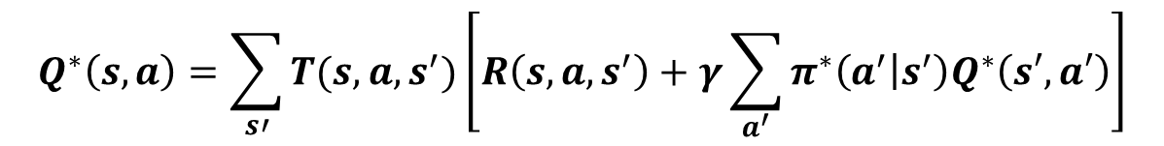
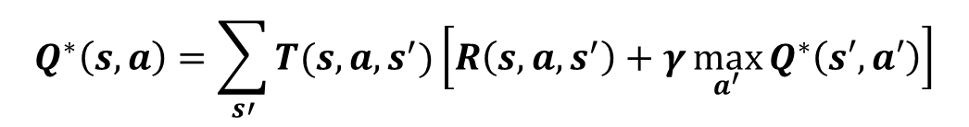
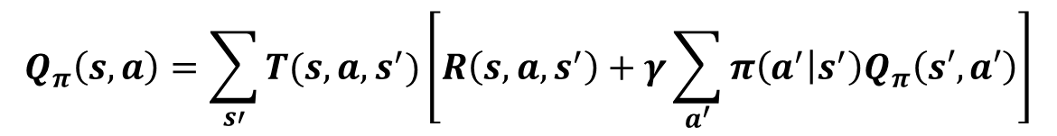

Bellman Optimality Equation for $Q^{∗}$
Action value equation:
$$Q_{π}\left(s,a\right)=\sum_{s′}{T(s,a,s^{′})\left[R\left(s,a,s^{′}\right)+γ\sum_{a^{′}}{{π\left(a^{′} | s^{′}\right)Q}_{π}\left(s′,a′\right)}\right]}$$
s
a
Substitute optimal policy:
s, a
$$Q^{∗}\left(s,a\right)=\sum_{s′}{T(s,a,s^{′})\left[R\left(s,a,s^{′}\right)+γ\sum_{a^{′}}{π^{∗}\left(a^{′} | s^{′}\right)Q^{∗}\left(s′,a′\right)}\right]}$$
s,a,s’
s’
Optimality equation for $Q^{∗}$:
$$Q^{∗}\left(s,a\right)=\sum_{s′}{T(s,a,s^{′})\left[R\left(s,a,s^{′}\right)+γ\max_{a^{′}}{Q^{∗}\left(s′,a′\right)}\right]}$$
Simplifying Assumption: rewards are fixed for (s, a, s’)
Credit: CS188 – Intro to AI, UC Berkeley, ai.berkely.edu
Credit: CS181 – Machine Learning, D. Parkes, Harvard Univ, Spring 2017
Notes:
Let’s start by equations that characterize these quantities through mutual recursions. [step through this by writing on slide, one step at a time]
Recursive characterization of V* in terms of V*; not necessarily helpful; but it is a characterization.
Note: this is a set of equations that needs to be satisfied; but it could have multiple solutions (it does not, but at this stage of our knowledge it could).

Slide 25

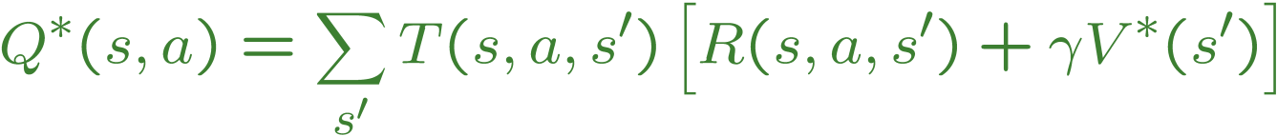
The Bellman Equations
s
a
s, a
s,a,s’
s’
<https://en.wikipedia.org/w/index.php?title=Markov_decision_process&oldid=855934986> [accessed 11 September 2018]

Slide 26
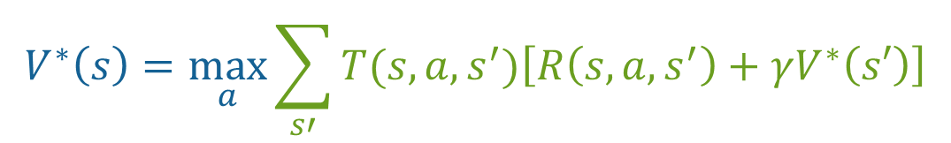
The optimal Value utility Equation V*
Focusing on different Bellman Equations Gives Different Algorithms
The V* equation gives rise to these algorithms previously discussed:
Value Iteration
Policy Iteration
[1]
[2]
$$V^{∗}\left(s\right)=\max_{a}\sum_{s′}{T(s,a,s^{′})\left[R\left(s,a,s^{′}\right)+γV^{∗}\left(s′\right)\right]}$$
Credit: CS188 – Intro to AI, UC Berkeley, ai.berkely.edu
Credit: CS181 – Machine Learning, D. Parkes, Harvard Univ, Spring 2017
Notes:
Let’s start by equations that characterize these quantities through mutual recursions. [step through this by writing on slide, one step at a time]
Recursive characterization of V* in terms of V*; not necessarily helpful; but it is a characterization.
Note: this is a set of equations that needs to be satisfied; but it could have multiple solutions (it does not, but at this stage of our knowledge it could).

Slide 27
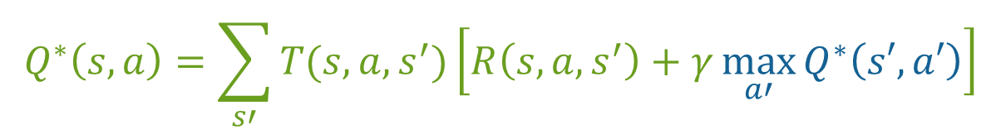
The optimal Value utility Equation Q*
[1]
The Q* equation gives rise to the Q-Learning algorithm.
[2]
$$Q^{∗}\left(s,a\right)=\sum_{s′}{T(s,a,s^{′})\left[R\left(s,a,s^{′}\right)+γ\max_{a′}{Q^{∗}\left(s′,a′\right)}\right]}$$
Credit: CS188 – Intro to AI, UC Berkeley, ai.berkely.edu
Credit: CS181 – Machine Learning, D. Parkes, Harvard Univ, Spring 2017
Notes:
Let’s start by equations that characterize these quantities through mutual recursions. [step through this by writing on slide, one step at a time]
Recursive characterization of V* in terms of V*; not necessarily helpful; but it is a characterization.
Note: this is a set of equations that needs to be satisfied; but it could have multiple solutions (it does not, but at this stage of our knowledge it could).

Slide 28

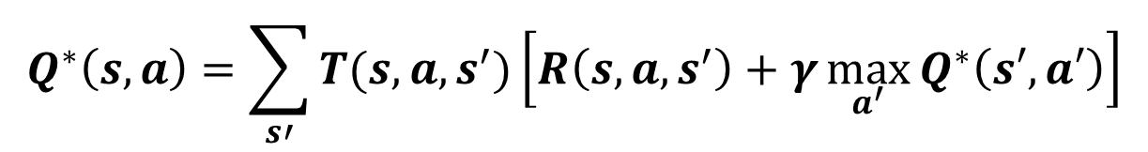

Q-Learning Update Rule (1)
What to do about T(s,a,s’) and R(s,a,s’), since we don’t have these functions?
$$Q^{∗}\left(s,a\right)=\sum_{s′}{T(s,a,s^{′})\left[R\left(s,a,s^{′}\right)+γ\max_{a^{′}}{Q^{∗}\left(s′,a′\right)}\right]}$$
Use sampling to learn Q(s,a) values as you go
Receive a sample transition: (s,a,r,s’)
Consider your old estimate: $\text{Q}\left(s,a\right)$
Consider your new sample estimate:
Incorporate the new estimate into a running average based on the learning rate $α$:
$$r+γ\max_{a′}{Q_{k}\left(s′,a′\right)}$$
$$Q\left(s,a\right)←\left(1−α\right)Q\left(s,a\right)+α\left[R\left(s,a,s^{′}\right)+γ\max_{a′}{Q_{k}\left(s′,a′\right)}\right]$$

Slide 29

Q-Learning update rule (2)
On transitioning from state s to state s’ on action a, and receiving reward r, update:
$α$ is the learning rate
A large $α$ results in quicker learning but may not converge.
$α$ is often decreased as learning goes on.
$γ$ is the discount rate i.e., discounts future rewards
target
$$Q_{k+1} \left(s,a\right)←Q_{k}\left(s,a\right)+α\left[r+γ\max_{a′}{Q_{k}\left(s′,a′\right)}−Q_{k}\left(s,a\right)\right]$$

Slide 30
Q-Learning update rule: An Alternate Interpretation
target
$$Q_{k+1} \left(s,a\right)←Q_{k}\left(s,a\right)+α\left[r+γ\max_{a′}{Q_{k}\left(s′,a′\right)}−Q_{k}\left(s,a\right)\right]$$
new
old
$$Q_{k+1} \left(s,a\right)←\left(1−α\right)Q_{k}\left(s,a\right)+α\left[r+γ\max_{a′}{Q_{k}\left(s′,a′\right)}\right]$$

Slide 31

Q-Learning algorithm
For each state s and action a:
$Q\left(s,a\right)←arbitrary value$
Observe initial state s
Repeat:
Select and carry out an action a
Receive reward r and observe new state s’
With transition <s,a,r,s’>, update Q(s,a):
$Q_{k+1}\left(s,a\right)←\left(1−α\right)Q_{k}\left(s,a\right)+α\left[r+γ\max_{a′}{Q_{k}\left(s′,a′\right)}\right]$
s $←s′$
Until terminated

Slide 32
The Q-Learning Algorithm Converges on the True q-value
The max_{a’} Q(s’,a’) that we use to update Q(s,a) is only an approximation and in early stages of learning it may be completely wrong.
However the approximation get more and more accurate with every iteration and it has been shown, that if we perform this update enough times, then the Q-function will converge and represent the true Q-value.
<https://www.intel.ai/demystifying-deep-reinforcement-learning> [accessed 29 January 2020]

Slide 33
choosing an action: exploration vs exploitation
How should an agent choose an action? An obvious answer is simply to follow the current policy. However, this is often not the best way to improve your model.
Exploit: use your current model to maximize the expected utility now.
Explore: choose an action that will help you improve your model.

Slide 34

ϵ-Greedy Method
With probability 1 - ϵ:
select the action with the maximum value.
$$A_{t}=argmax Q_{t}(a)$$
With probability ϵ:
randomly select an action from all the
actions with equal probability.

Slide 35
Q-Learning Example: gridworld
DEMO:
# run manually using arrows keys (-m)
python gridworld.py -w 200 -k 40 -s 0.2 -a q -d 1.0 -m
Notes:
python gridworld.py -k 40 -w 200 -s 2.0 -a q –v [-p]

Slide 36
Q-Learning Example: gridworld
DEMO:
# run fast automatically (-s 2.0) with living reward 0.0
python gridworld.py -w 200 -k 40 -s 2.0 -a q -d 1.0
Notes:
python gridworld.py -k 40 -w 200 -s 2.0 -a q –v [-p]

Slide 37
Q-Learning Example: gridworld
DEMO:
# run fast automatically (-s 2.0) with living reward -0.1 (-r -0.1)
python gridworld.py -w 200 -k 100 -a q -d 1.0 -r -0.1
Notes:
python gridworld.py -k 40 -w 200 -s 2.0 -a q –v [-p]

Slide 38
Q-Learning Example: gridworld
DEMO:
# get there carefully with living reward -0.0085
python gridworld.py -w 200 -k 100 -a q -d 1.0 -r -0.0085 -q
Notes:
python gridworld.py -k 40 -w 200 -s 2.0 -a q –v [-p]

Slide 39
Q-Learning Example: gridworld
DEMO:
# get there carefully with living reward -0.0085 after 100 episodes
python gridworld.py -w 200 -k 100 -a q -d 1.0 -r -0.0085 -q
Notes:
python gridworld.py -k 40 -w 200 -s 2.0 -a q –v [-p]

Slide 40
Q-Learning Example: gridworld
DEMO:
# get there fast with living reward -0.1 after 100 episodes
python gridworld.py -w 200 -k 100 -a q -d 1.0 -r -0.1 -q
Notes:
python gridworld.py -k 40 -w 200 -s 2.0 -a q –v [-p]

Slide 41
Q-Learning Example: gridworld
DEMO:
# die fast with living reward -1.0 after 100 episodes
python gridworld.py -w 200 -k 100 -a q -d 1.0 -r -1.0 -q
Notes:
python gridworld.py -k 40 -w 200 -s 2.0 -a q –v [-p]

Slide 42
Q-Learning Example: gridworld
DEMO:
# stay alive indefinitely with living reward 1.0 after 100 episodes
python gridworld.py -w 200 -k 100 -a q -d 1.0 -r 1.0 -q
Notes:
python gridworld.py -k 40 -w 200 -s 2.0 -a q –v [-p]

Slide 43
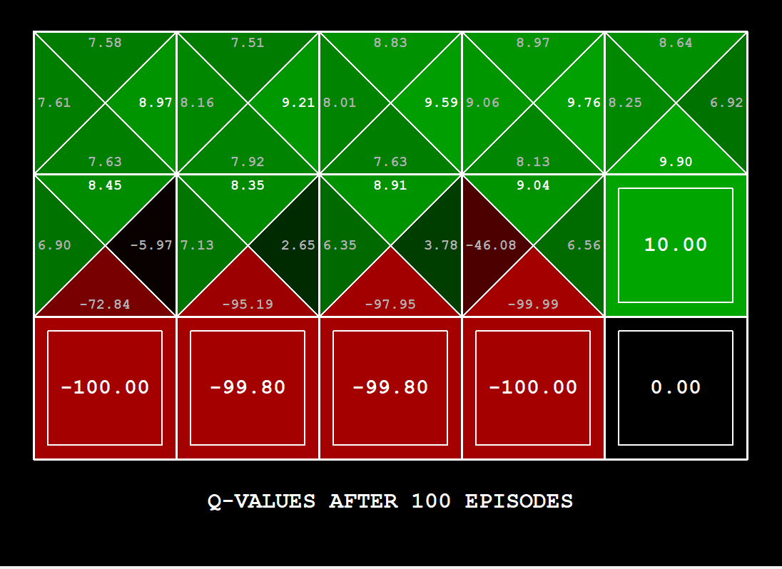
Q-Learning Example: gridworld
DEMO:
# avoid cliff with living reward -0.1 after 100 episodes
python gridworld.py -w 200 -k 100 -a q -d 1.0 -g CliffGrid -l 0.5 -r -0.1 -q
Notes:
python gridworld.py -k 40 -w 200 -s 2.0 -a q –v [-p]

Slide 44
Q-Learning Example: gridworld
DEMO:
# ignore the cliff with living reward -25.0 after 100 episodes
python gridworld.py -w 200 -k 100 -a q -d 1.0 -g CliffGrid -l 0.5 -r -25.0 -q
Notes:
python gridworld.py -k 40 -w 200 -s 2.0 -a q –v [-p]

Slide 45
Introduction To Q-learning
Scott O’Hara
Metrowest Developers Machine Learning Group

Slide 46
Extra SLides

Slide 47
Q-Learning Example: gridworld
Notes:
python gridworld.py -k 40 -w 200 -s 2.0 -a q –v [-p]

Slide 48
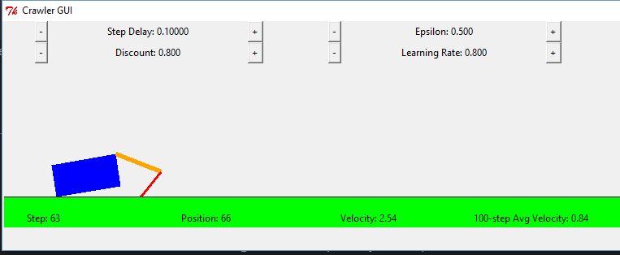
Q-Learning Example: Crawler Robot
Credit: CS188 – Intro to AI, UC Berkeley, ai.berkely.edu

Slide 49
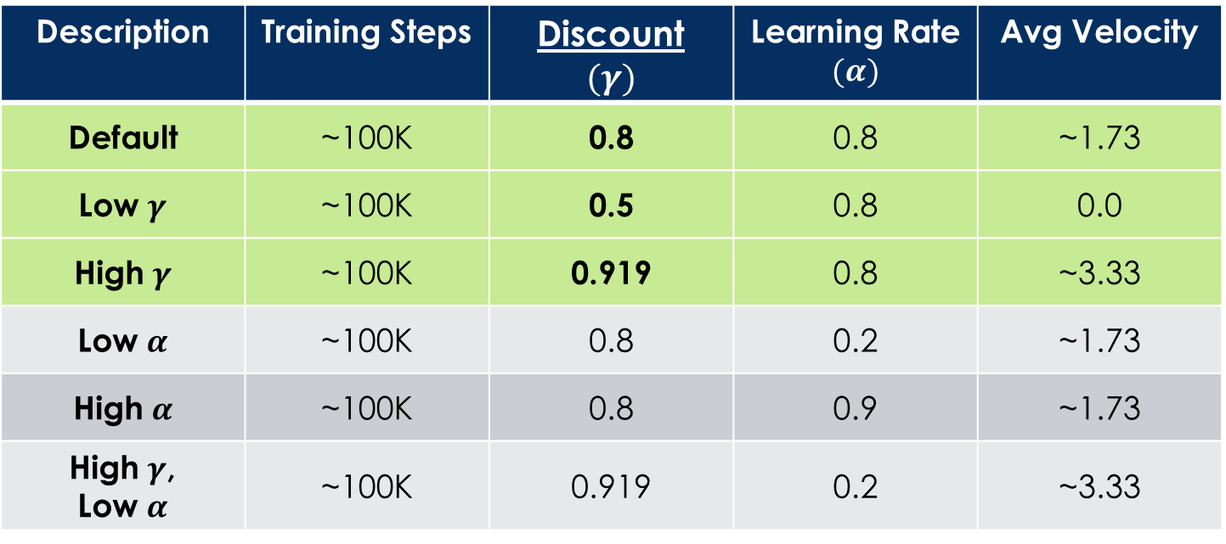
Q-Learning Example: discount effect
Update rule:
Description | Training Steps | Discount $$(γ)$$ | Learning Rate $$(α)$$ | Avg Velocity
Default | ~100K | 0.8 | 0.8 | ~1.73
Low $γ$ | ~100K | 0.5 | 0.8 | 0.0
High $γ$ | ~100K | 0.919 | 0.8 | ~3.33
Low $α$ | ~100K | 0.8 | 0.2 | ~1.73
High $α$ | ~100K | 0.8 | 0.9 | ~1.73
High $γ$, Low $α$ | ~100K | 0.919 | 0.2 | ~3.33

Slide 50
References
“Demystifying Deep Reinforcement Learning,” 2015, Tambet Matiisen
https://www.intel.ai/demystifying-deep-reinforcement-learning/
CS188 course at University of California, Berkeley:
CS188 – Introduction to Artificial Intelligence, Profs. Dan Klein, Pieter Abbeel, et al. http://ai.berkeley.edu/home.html
CS181 course at Harvard University:
CS181 Intelligent Machines: Perception, Learning and Uncertainty, Sarah Finney, Spring 2009
CS181 Intelligent Machines: Perception, Learning and Uncertainty, Prof. David C Brooks, Spring 2011
CS181 – Machine Learning, Prof. Ryan P. Adams, Spring 2014. https://github.com/wihl/cs181-spring2014
CS181 – Machine Learning, Prof. David Parkes, Spring 2017. https://harvard-ml-courses.github.io/cs181-web-2017/
Reinforcement learning: an introduction R. S. Sutton and A. G. Barto, Second edition. Cambridge, Massachusetts: The MIT Press, 2018.
The material for this talk is primarily drawn from the slides, notes and lectures of these courses with occasional reference to Sutton and Barto’s book.

Slide 51
UC Berkeley CS188 is a great resource!
Websites:
http://ai.berkeley.edu/home.html
http://gamescrafters.berkeley.edu/~cs188/sp20/
http://gamescrafters.berkeley.edu/~cs188/{sp|fa}<yr>/
Covers:
Search
Constraint Satisfaction
Games
Reinforcement Learning
Bayesian Networks
Surveys Advanced Topics
And more…
Features:
Contains high quality YouTube videos, PowerPoint slides and homework.
Projects are based on the video game PacMan.
Material is used in many courses around the country.

